Slide 1
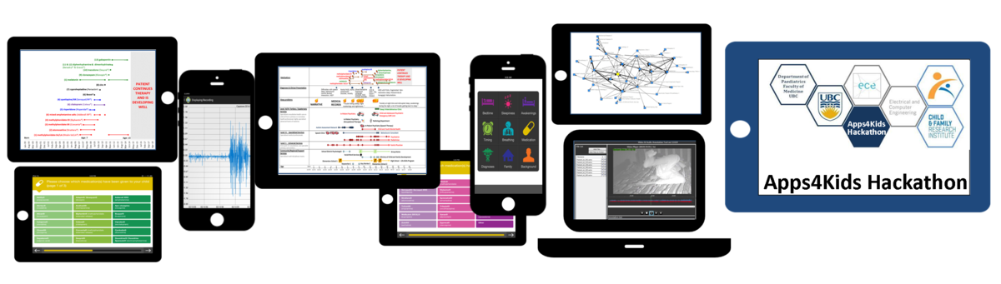


Slide 2

The Team
LED BY:
Dr. Vishal Avinashi
TEAM MEMBERS:
Sohail Vaghari, Dou Mok, Kayla Lee, John Lim, Aditi Chak, Akiff Manji, Lisa Wong, Eric Kim, Yi Tan

Slide 3
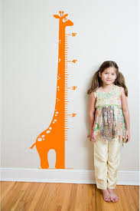
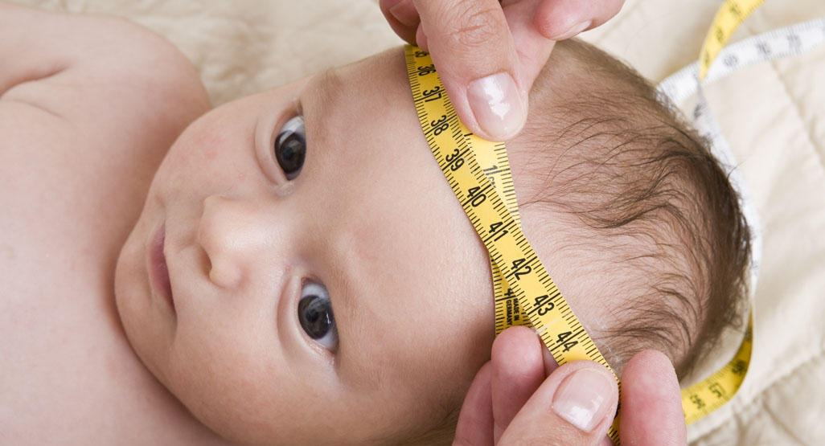

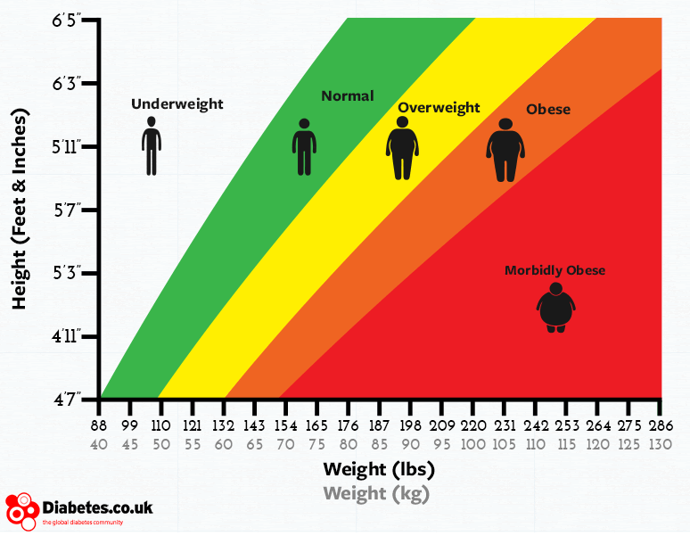
Introduction
height
head circumference
weight
BMI
http://www.babycenter.com/0_growth-charts-taking-your-babys-measurements_1620.bc?page=2
http://www.interiorclip.com/interior/961x1440/growth-chart-giraffe-via-etsy-12878.html
http://makingitallfit.com/2012/07/26/you-dont-need-a-weight-goal-it-is-only-keeping-you-stuck/feet-on-scale/
http://www.diabetes.co.uk/bmi.html
Notes:
Present Idea & Proposed Project – 2mins
VISH
**include applications to chronic conditions
Appropriate growth is a measure of good health
This involves serially measuring and tracking:
length/height
head circumference
weight
BMI

Slide 4

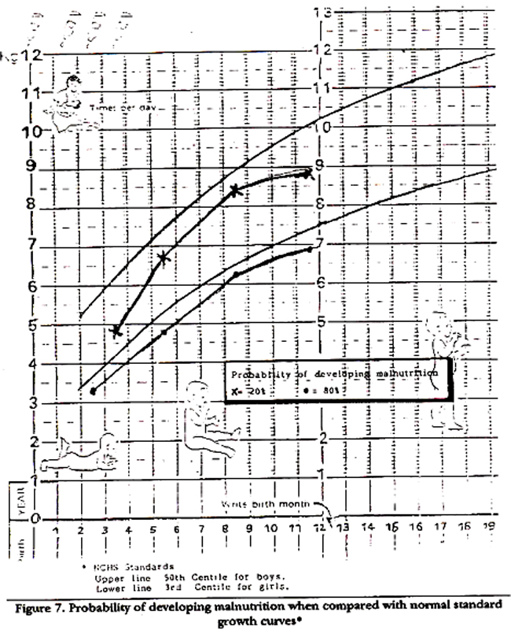
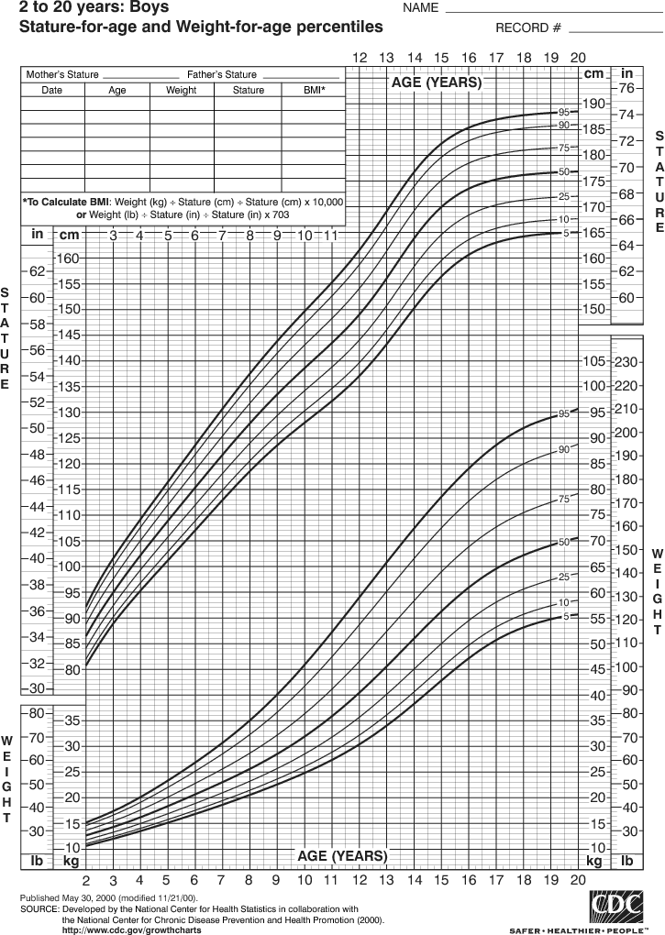

Issues With Paper Charts
http://www.clker.com/clipart-1790.html
http://www.nzdl.org/gsdl/collect/fnl2.2/archives/HASH01ad.dir/p213b.gif
Notes:
VISHAL
(Paper charts is what they use in the hospital by the way :o …)
Current charts are:
hard-to-read (dots are sometimes close too close together)
does not provide exact percentiles
hard-to-plot because on paper (get faxed + photocopied)
use the old CDC curves
Incomplete b/c they’re living in different places
not accessible to patients

Slide 5

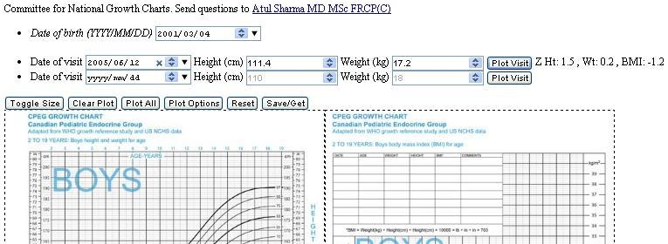

Problem With Electronic Charts
http://www.woodshomes.ca/images/content/pagebuilder/Mother_son_and_daughter.jpg
X
http://maryafischer.com/wp-content/uploads/2012/09/Misdiagnosed-When-Your-Doctor-Doesnt-Know.jpeg
http://www.bcchildrens.ca/Services/SpecializedPediatrics/EndocrinologyDiabetesUnit/ForProfessionals/GrowthChartPlotterApp.htm
Notes:
KAYLA
Current charts are:
Physician exclusive (not available to the families)
Not user-friendly
time-consuming
Based on older CDC curves
No export features
Can’t save the data

Slide 6








Limitations with Existing Solutions
X
X
X
X
X
X
X
Platform-specific and device-exclusive
Notes:
KAYLA
Shortcomings of existing apps include:
Lack of data storage
Device and platform specific
Some aren’t mobile friendly etc.
Not user-friendly; more physician than patient-oriented

Slide 7










Our Approach
database
front-end
back-end
open source file-sharing
Notes:
AKIFF
Django
R
Javascript
Python
Postgres
Bootstrap
Git
HTML/CSS
Make it easy for patients to input and share the data
(Include the multiple growth points)
(Ability to switch between curves)
Visually appealing (graphs)
Maintaining accuracy (tables + calculations)
Make it easy for patients to input and share the data
(Include the multiple growth points)
(Ability to switch between curves)
Visually appealing (graphs)
Maintaining accuracy (tables + calculations)

Slide 8
Demo
DEMO

Slide 9
Feedback
“As a parent of a child with a chronic condition, it provides me ease of mind to be able to view and track my child’s growth”
Parent of child with inflammatory bowel disease
“This is great first step that enables parents to take charge of their children’s health.”
Parent of newborn child
Notes:
SOHAIL

Slide 10

Future
Implement different growth curves:
Down’s Syndrome
CDC/SET I
Enable physician log-in
Implement e-mail notifications
Link to developmental milestones
http://www.clker.com/clipart-1790.html
http://www.clker.com/clipart-team.html
Notes:
SOHAIL
Implement different growth curves
E.g. Down’s Syndrome
Enable physician log-in to view parent inputted growth points
Email notifications
Parents will automatically get email notifications of when to input growth information
- Compare data with different growth curves (e.g. CPEG, WHO)

Slide 11


